Slide 1

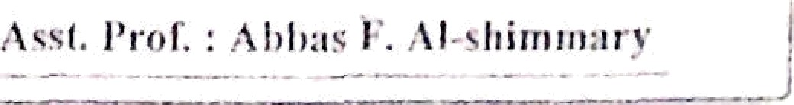
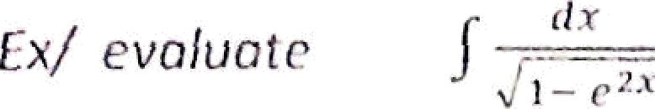

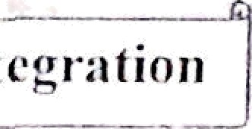
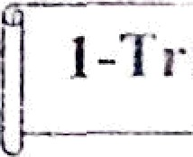
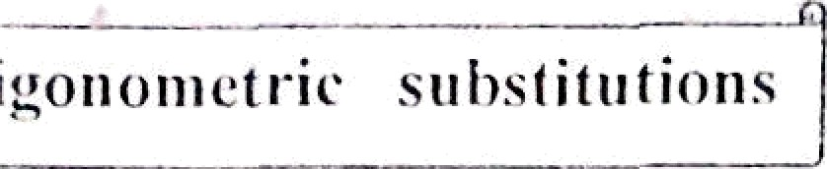
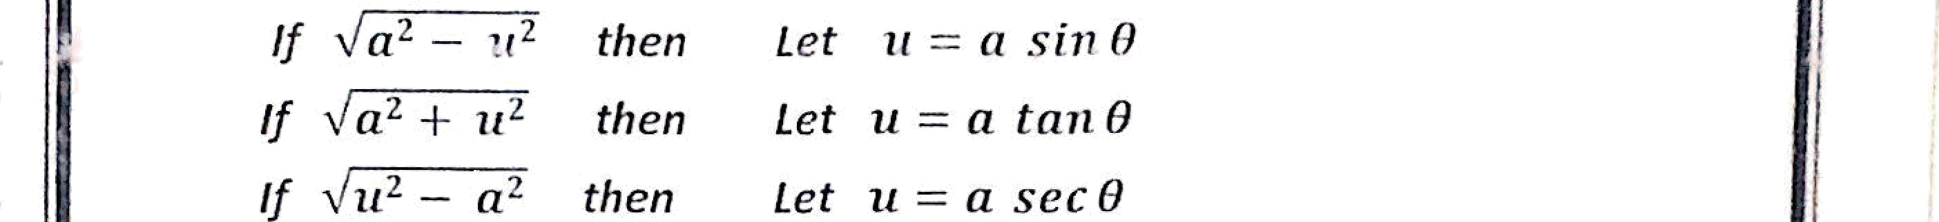
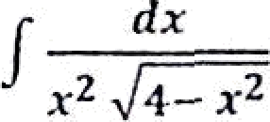
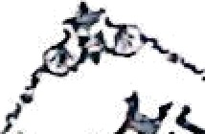




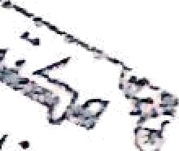






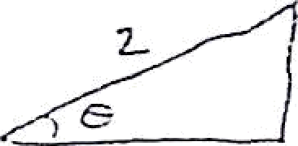


— f :
e
let u -— e* —i du -— e" dx
Techniques of lniegr•otion
Yx / evaluate
Let x = 2 sin 0 =<
_
dx = 2 cos 8 d8 q¡
2 cosB dB
4 n*8
4sn
os 0 dB
2 ₀
1
1
s
s n 6
t
.
cos0 d0
sin*0 cds 0
_ 1
#
0
siMB B
= ( / cse' 8 d8
p
v x = 2 sin 8 —› °
-1 4 x
= sin 8
+ C
let x = 5 sec 8
=t dx = 5 sec 8 tan 8 d8
2 ec 2S (fi Kc 8 tan 8 d8 )
—— 1
= 5 / Uh)
tan 0 dfl

Slide 2






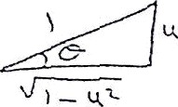


!\'finlliemaIi‹-.s” / /". c'/‹/.+ ›
= S tan ' IN tlO
= S } sec"O — 4 ]d0
= 5 [tan 8 — 0] + c
x = °› sec 8
S
O)- StC’ ^{l}
sec 0
) fl
=5( ,
x'
x
- ec ){+c
+ c
= x
£x / evaluateg ] ₃+ ),
— 5 sec”' (
Let x =
_
fan 8
sec‘ 8 d8
dx = 3 sec' 8 d8
sec' 8 de _ i
3’/' l -i- t» n' O ) ’ /’ 3
ec' g dB
I
cos 8 ?l8 ——
sect 0
3
sin 8 + c
1 x
3
+c
Ex/ evaluate
Ț e‘ | 1 | e | dx
 | Let | u = | e' | du = e" dx
J liu
Let u — sin 8
du
du — cos 8 d8
- = sin 8 ,
sin‘' u = B
—— J cos 8 d8
—- f ozs 8 cos 8 d8
s in²
—— / cos² 6 d0
J(1 + cos 2 8 )d8
1 1
z ej +
sin 2 8 = 2 sin 8 cos 8
2 [ 8 + 2 (2 sin 8 cos 8)] -I- c
82

Slide 3
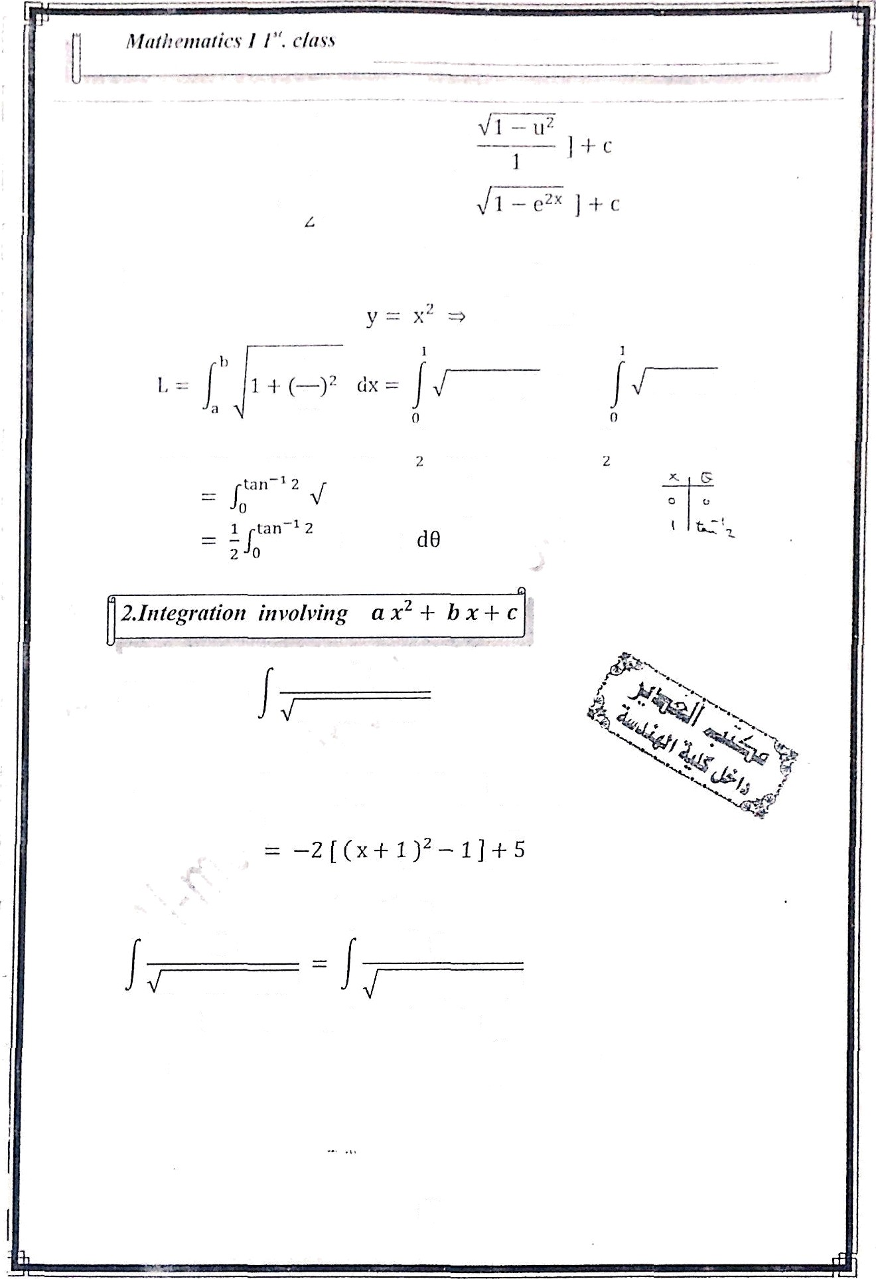
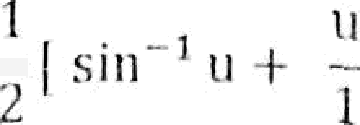

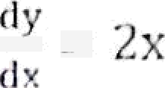
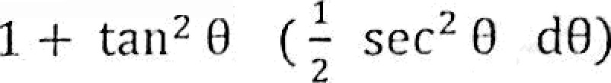



lx i’ Îiïld ÎÔc llrc lcngtll of ÎÎIC clxl-vC
X' frolTl x -
Îo Ñ 1
y
dx
1 -1- ( 2x)* dx —
tan 0 => dx
1 + 4x^ dx
Let lx — tan
x
₋1
des' 6 d
sec' 8
Ex/»aluate
5 4x
_{2 x} 2
5 4x
_{2 x}2
2 ( x² -l- 2x ) -l- 5
2 ( x' -l- 2 x + 1
1 ) + 5
1 (x + 1 )' + 2 4
2 (x -1- 1 )²
dx
1 2 ( x + 1)'
Let u x + 1 m du dx
Let gÑ
7
dx
5 4x — 2 x²
— IÉ six 8 —+ du
cos8 d8
83

Slide 4
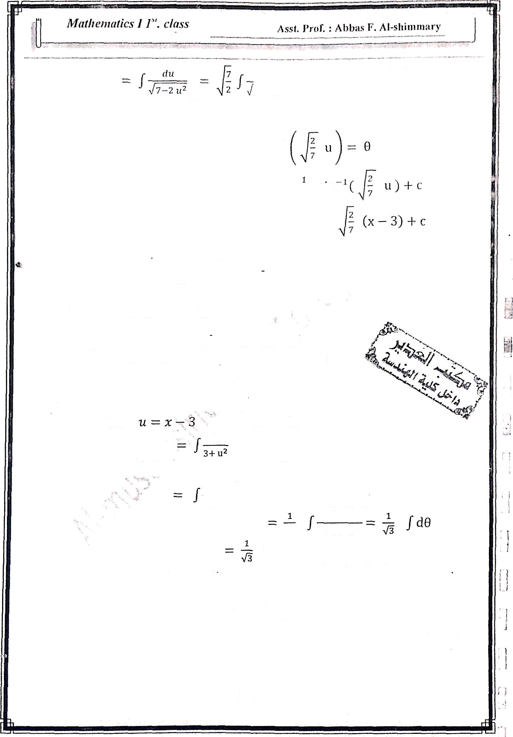


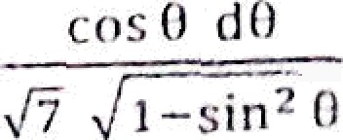

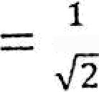






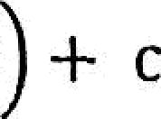


vosB d0
7 — 7 siri 8
ccs 0 d8
i
/ d0 =
w sin
8 -\- c
u — siu 0
1
=
sin
1
sin°'(
Ex/ evaluote
_{,)} cos 8 d8
si n² 0 —6 sín 8 -F 12
Let x = sin 8 m
cos 8 d8
dx —— cos 8 d8
dx
sí ii² 8 —6 siri 8 -I-12
x*— s x + iz
x' — 6 x + 12 = x² — 6x -F 9 — 9 + 12
— ( x — 3 )' + 3
dx
31( x—3 )'
Lel
du —— dx
du
Let u - "›/É ”tan 0
W du =
3 sec² 0 dB
\!É sec ² 0 d0
3 sec' 0 d0
3 1+tan*B
3
8 + c =
sec’B dB
₃1
sec*0
tan"' ( ) -I- c
( 3) 3- c
= 3 tan
_{tan° 1 (} sín 8—3

Slide 5
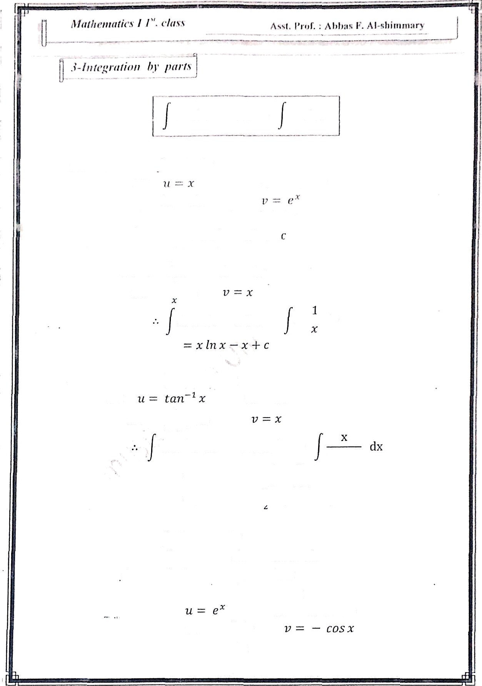


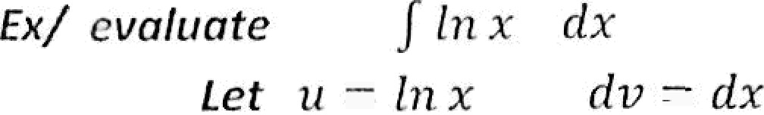


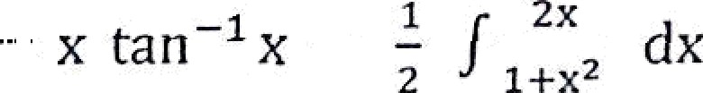
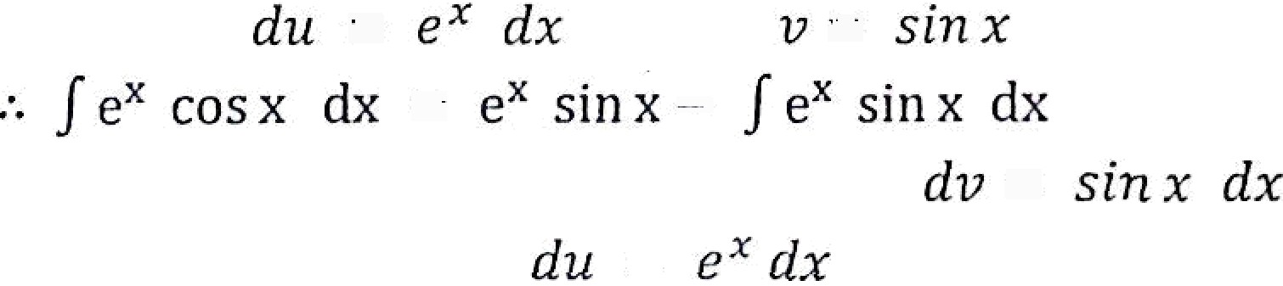
in x dx
x in x
x . dx
EK / evaluate
Let
du
fru ' dx
¹ , di
tan
¹ X dX
— X C8 n
1 _{X}
1+x’
x tan*' x
in) 1 -J- x² + c
Ex/ evaluat
Let
e* cos x dx
u - e^ du
ros dx
85

Slide 6
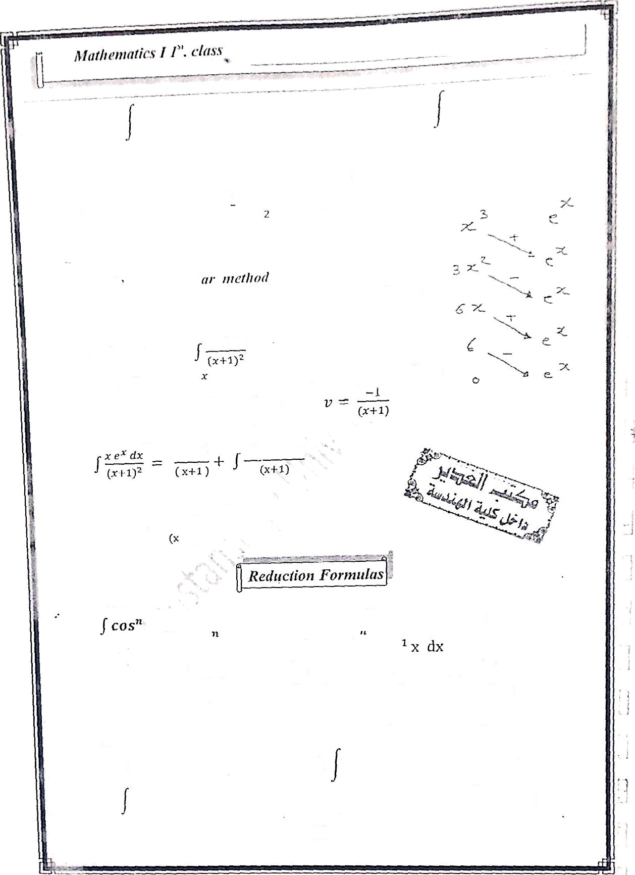

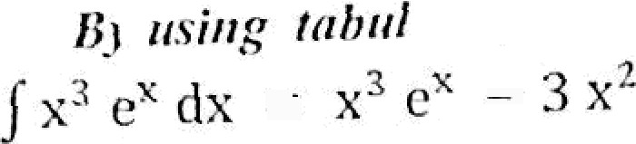

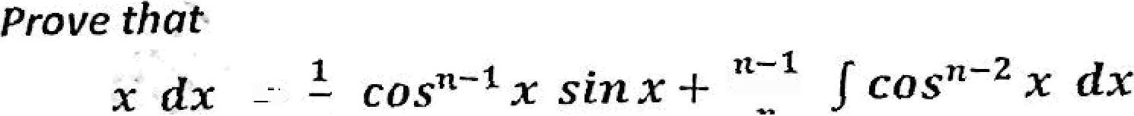
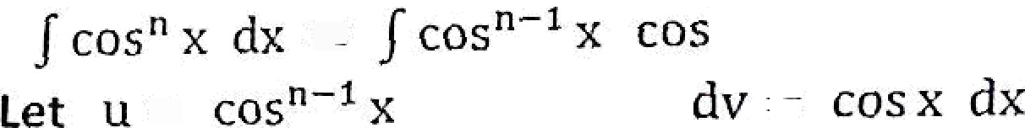

».‹.›,.f • ‹*"••'•^Ł °*
2 / c' cos x d›
/ e' co.s x dx
e^ sín x + e^ cos x
e^ sin xc e^ cos x
e^ + 6x e‘
6e' +
C
6x/ evaluate
tel u-xe
x e^ ix
dv •
1)"
dx
Şu — (x e” T e’)da
du
e^ ( K -I- 1 )6x
(x-F1)
—x eX +
e" dx
e• +
du
(n - l) Cos* X
SİII x ) dx
v sin x
/ cos" x dx — cos"*' x sin x -L (n
1) / sin² x cos°* ² x dx
cos' x ) cos *² x dx
^{t} cos *' x sin x
(n 1) (1
cos° x dx = cos^{t} *' x sin z I (ø — 1)
COS“ ' X £ÎX - ( — 1)
COS

Slide 7
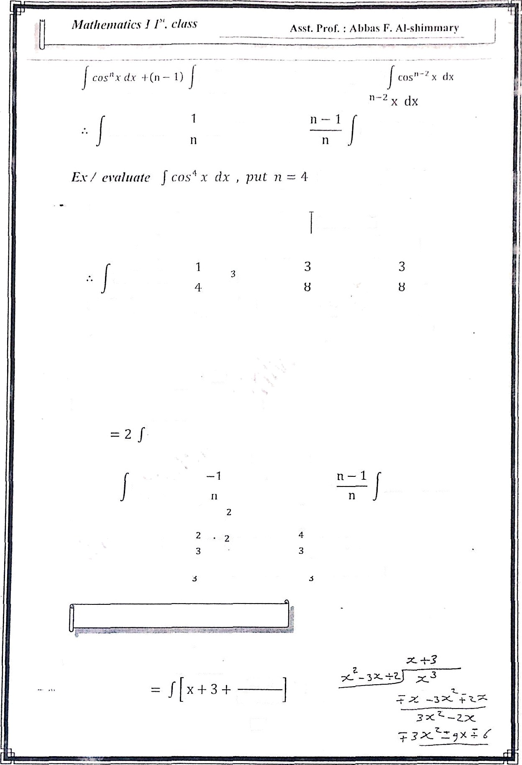






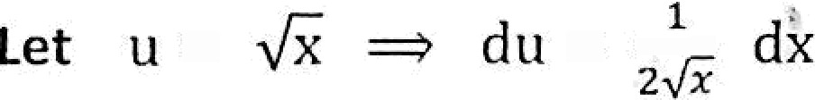

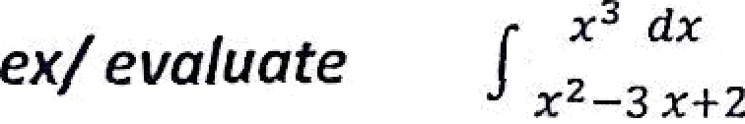
cos^{n} x dx
cos°°¹ x sin> -1-
cos' ' dx
in nhcve f ormiilu
cos’ x sin x + )— / cos' x dx
/ cos’ x dx
1
1
1
COS' X SÍ n X + '
- COS x sin x +
cos’ x dx — cos x sin x -J- _ cos x sin x -l- _ x 1 c
imlarly we tan prove that
x cos x -F ‘.' ^{k}/ sin dx
*' x
Ex: evah‹ate
' dx
sin ³ ( )
dx 2 / sin^{k} u du
Pat n 3
[ sinrl ' x cos x ] +
'
2
sin"' x dx
k
sin *'
x dx
2 / sin' u du • 2 [
sin u cos u +
— sin u cos u
- SHI' X COS
sin u du ]
3
— cos u -l- c
— — COS
+ C
4- Iniegrafíon
bJ partial fracíions
7x—6
x² —3 x-F2
dx
3

Slide 8

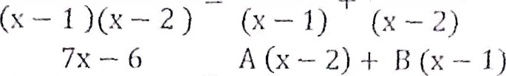




,ş „t.
l’r‹if. :
bl,:is 1'’. ›ì 1-sliíniinii rs'
--5
7x — G
A
¡j
(*
i)(x — 2) (x — i)(x — z)
7x — €› — Ax — 2A + ßx — 8
7x — 6 = A + B ) x — 2 A - D
. A + d = 7
—2 A — B = | —G
— A — 1 | A = | —1 | , B = 8
7x — G dx |  | — î dx + | 8 ‹ix
(x — 1)(x — 2) | J | x — 1 | J x — 1
= — ln¡
- 1 ¡ + s in{x — z J + c
Ex: ernfiinte
1
dx
x — 1)( z + 1)²
A B
C
(x — 1 (x +' 1) |  | (x — 1) + (x + 1) “ (x + l |  |  |  | '
1 _ |  | (x+1j"+ B (x—z)(x+1)+ c (x—I)
fa—1›( +1)' " 1 == A.( x’ |  | (*—1›(•+1›' -i- 2x -i- 1 ) —I B (x' |  | — 1) + |  | c (x — 1)
1 | — Ã x' | -I- 2 Ax + A -ł- B x' | — | B + | CA — C
0x' -ł- 0x -ł- 1 = (A + B)x' -ł- (2 A —I- C)x + A — B — C A -I— B — 0
2 A + C = 0 A - B — C = 1
ad’ ’’
3A — B = 1 A + B = 0
add
4 A = 1 =r A -
t — i)t +1)'
1
B
1
4 ’
4
1/4 1/4 1/2
- I) ‹.+ i) (.+ )'

Slide 9


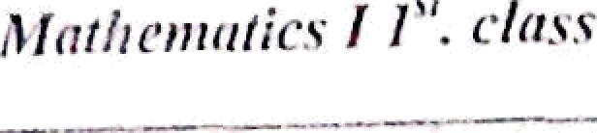
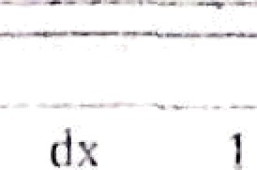




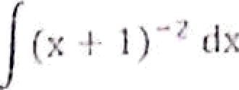




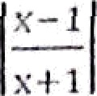












dx T
)jy1)*’Æ’
i
= - In) x — 1] — In jx 4 I) —
4
Ex/ evaluate
! (.-2 ‘.• + ›
A
1
)( ' 1) ( —
i
(x — 2) ( '-F 1)
IN x -ł- c
) (X ² -F 1$
A (x² -I- 1) + (B x -F c)(x — 2)
(x — 2
x'
1 — A(x' -1- 1) -ł- (BX -ł- )( — )
1 = A x2 + A + B x' — 2B x -Ł C x — 2 C
0z ² + 0x + 1 -
A 1 = 0 C — 2B = 0 A —2C = ï.
(A -F B)x² -I- (C — 2B)x -1- A — 2C
==> 2C — 4B
0
A —2C = 1
add
A — 4B 1
é“= B - 0 add
—5 B = 1 ==> B = —
A -
1
S
c=
2
5
1
1/5
— (x — 2) ⁺
—1/5x — 2/S
(x' + 1)
(x’ -
2)( ² + 1)
dx
2 (x '-I- 1)
1 dx 1 x dx 2 dx 5 x — 1 Ś x^ + 1 Ś x² -I- 1
—¹ IInn(x — 2) —
g In ) x² -I- 1 —
tank ^{s} x -I- c

Slide 10
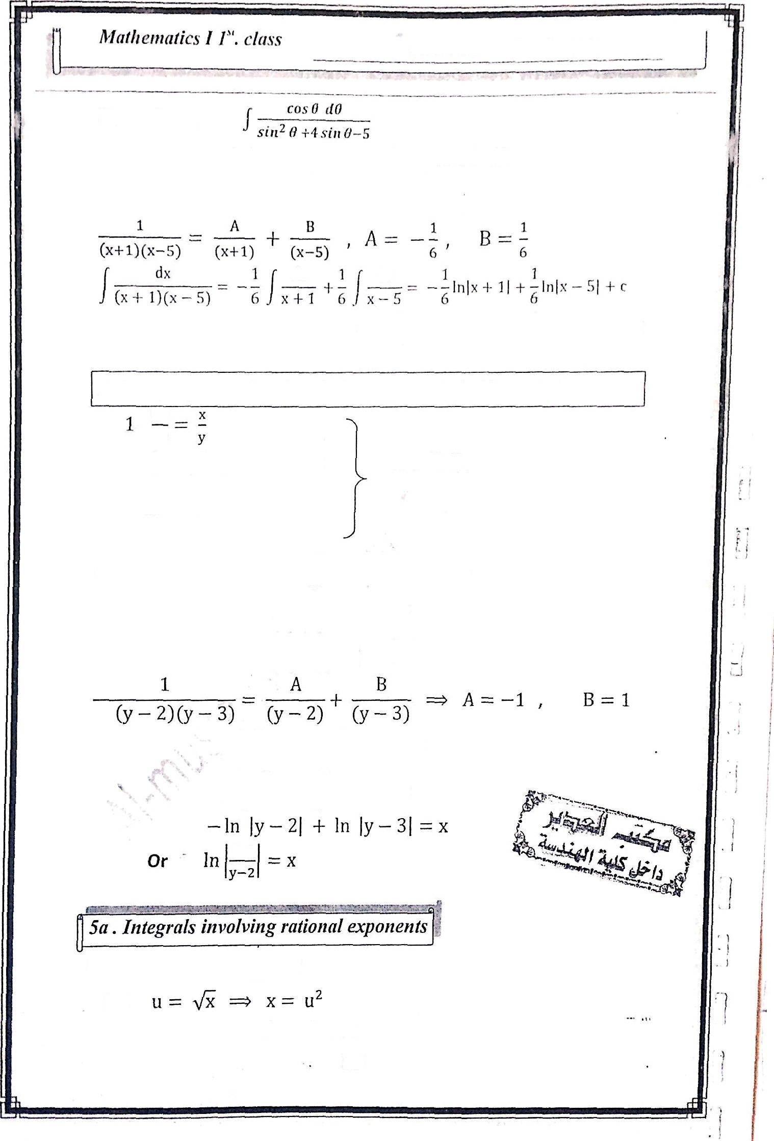



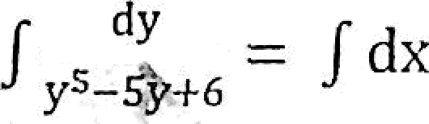



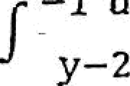
Asst. Prof. : Abbas F. Al-sliimma ry
Ex: e'vaIuate
Let x — sii› 8 w
d
dx = cos 8 d0
(x+1)(x-5)
* x'
‹x- s '
dx
dx
6
] sin 8 + 1[ + ₆ In ) sin 8) + c
Def: Any equation involve derivative is called Differential equation
dy
dx
2. (x + y) dy = xy dx are B. Es.
dy
3. _{dx}
y+1
Ex/ solve the
D .E.
ay
dx
= / dx
A dy
° y—2
+ /
B dy
= / dx
y-3
+ Jy,° , - /dx
y-3
M/ evaluate
Let
_{f} 1+Vx
dx
1-ix
dx = 2 u du
90

